Slide 1
OLAP fundamentals

Slide 2
OLAP Conceptual Data Model
Goal of OLAP is to support ad-hoc querying for the business analyst
Business analysts are familiar with spreadsheets
Extend spreadsheet analysis model to work with warehouse data
Multidimensional view of data is the foundation of OLAP

Slide 3
OLTP vs. OLAP
On-Line Transaction Processing (OLTP):
  technology used to perform updates on operational or transactional systems (e.g., point of sale systems)
On-Line Analytical Processing (OLAP):
  technology used to perform complex analysis of the data in a data warehouse
    OLAP is a category of software technology that enables analysts, managers, and executives to gain insight into data through fast, consistent, interactive access to a wide variety of possible views of information that has been transformed from raw data to reflect the dimensionality of the enterprise as understood by the user. [source: OLAP Council: www.olapcouncil.org]

Slide 4
OLTP vs. OLAP
OLTP
OLAP
User
Function
DB Design
Data
View
Usage
Unit of work
Access
Operations
# Records accessed
#Users
Db size
Metric
Clerk, IT Professional
Day to day operations
Application-oriented (E-R based)
Current, Isolated
Detailed, Flat relational
Structured, Repetitive
Short, Simple transaction
Read/write
Index/hash on prim. Key
Tens
Thousands
100 MB-GB
Trans. throughput
Knowledge worker
Decision support
Subject-oriented (Star, snowflake)
Historical, Consolidated
Summarized, Multidimensional
Ad hoc
Complex query
Read Mostly
Lots of Scans
Millions
Hundreds
100GB-TB
Query throughput, response
Source: Datta, GT

Slide 5
Approaches to OLAP Servers
Multidimensional OLAP (MOLAP)
  Array-based storage structures
  Direct access to array data structures
  Example: Essbase (Arbor)
Relational OLAP (ROLAP)
  Relational and Specialized Relational DBMS to store and manage warehouse data
  OLAP middleware to support missing pieces
    Optimize for each DBMS backend
    Aggregation Navigation Logic
    Additional tools and services
  Example: Microstrategy, MetaCube (Informix)

Slide 6
MOLAP

Slide 7
Multidimensional Data
Sales Volume as a function of time, city and product
NY
LA
SF
Juice
Cola
Milk
Cream
10
47
30
12
3/1 3/2 3/3 3/4
Date

Slide 8
Operations in Multidimensional Data Model
Aggregation (roll-up)
  dimension reduction: e.g., total sales by city
  summarization over aggregate hierarchy: e.g., total sales by city and year -> total sales by region and by year
Selection (slice) defines a subcube
  e.g., sales where city = Palo Alto and date = 1/15/96
Navigation to detailed data (drill-down)
  e.g., (sales - expense) by city, top 3% of cities by average income
Visualization Operations (e.g., Pivot)

Slide 9
A Visual Operation: Pivot (Rotate)
NY
LA
SF
Month
Juice
Cola
Milk
Cream
10
Region
47
30
12
Product
3/1 3/2 3/3 3/4
Date

Slide 10
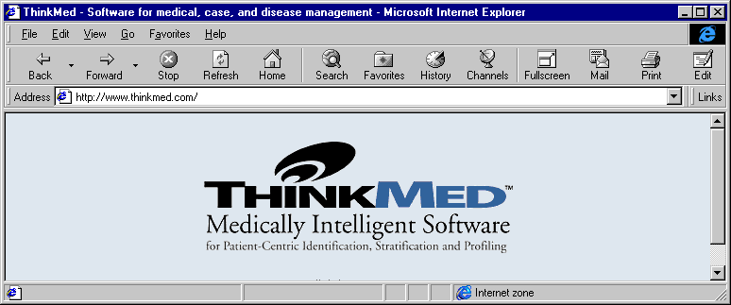
Thinkmed Expert: Data Visualization and Profiling (http://www.click4care.com)
http://www.thinkmed.com/soft/softdemo.htm

Slide 11
ThinkMed Expert
Processing of consolidated patient demographic, administrative and claims information using knowledge-based rules
Goal is to identify patients at risk in order to intervene and affect financial and clinical outcomes

Slide 12
Vignette
High risk diabetes program
Need to identify
  patients that have severe disease
  patients that require individual attention and assessment by case managers
Status quo
  rely on provider referrals
  rely on dollar cutoffs to identify expensive patients

Slide 13
Vignette
ThinkMed approach
  Interactive query facility with filters to identify patients in the database that have desired attributes
    patients that are diabetic and that have cardiac, renal, vascular or neurological conditions (use of codes or natural language boolean queries)
    visualize financial data by charge type

Slide 14
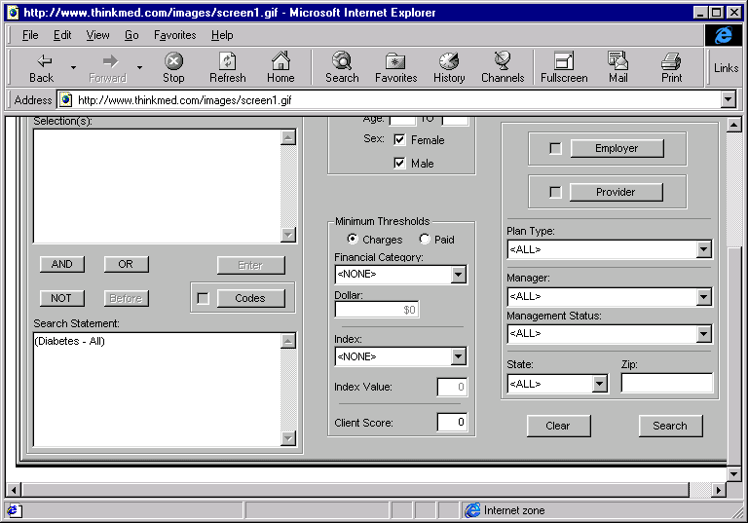

Slide 15
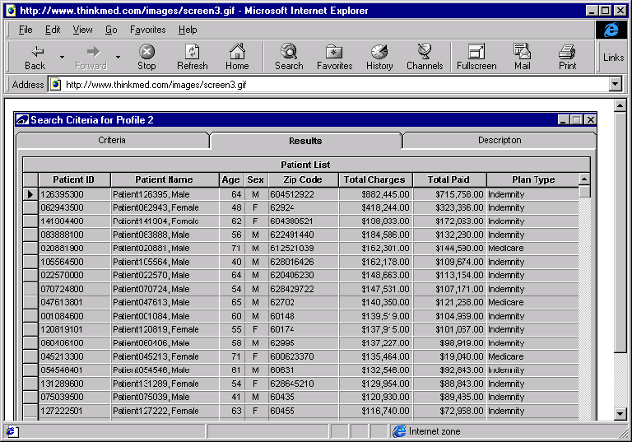

Slide 16
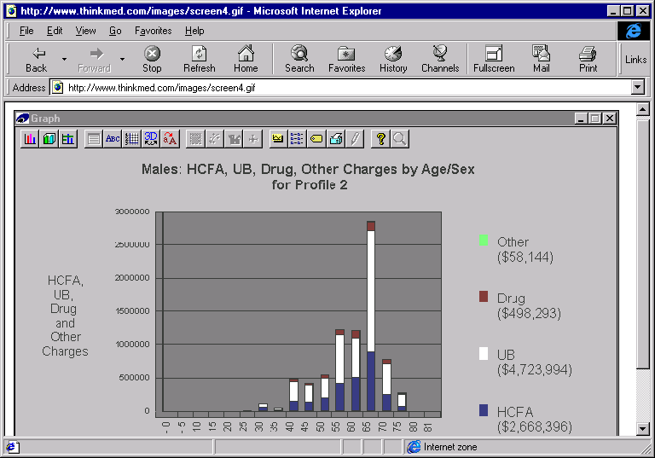

Slide 17
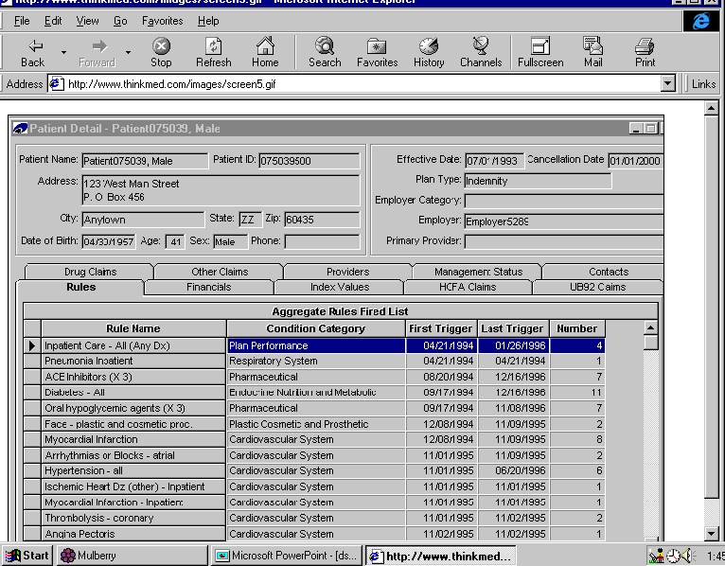

Slide 18
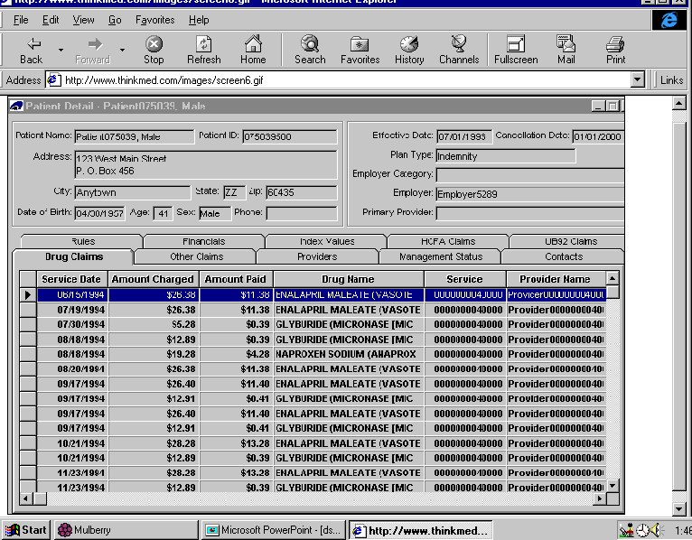

Slide 19
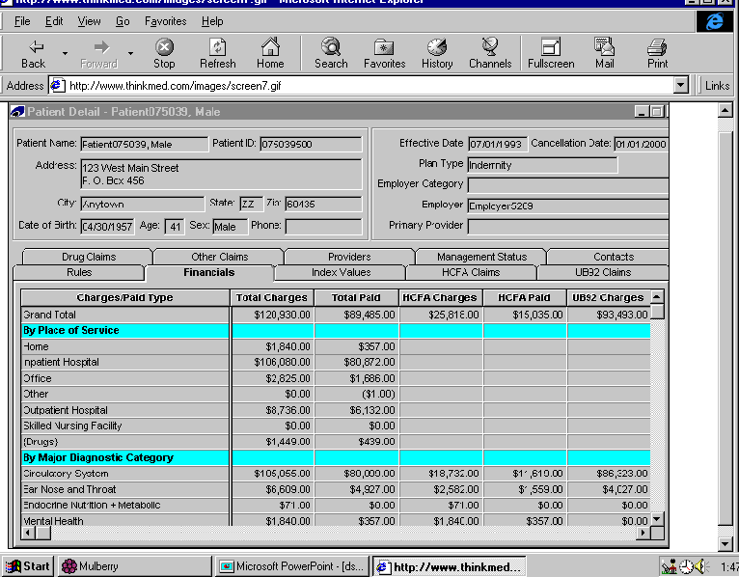

Slide 20
Administrative DSS using WOLAP

Slide 21
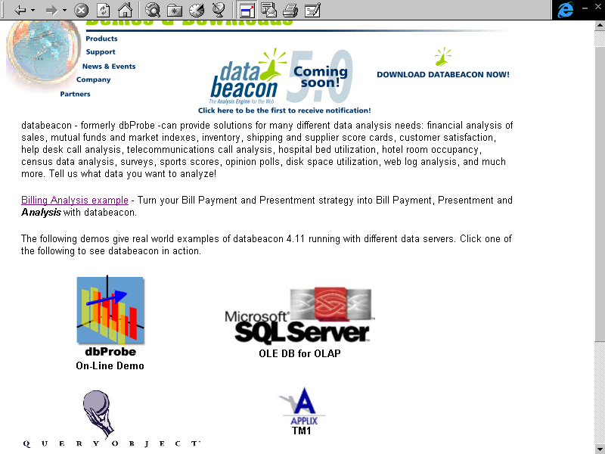

Slide 22
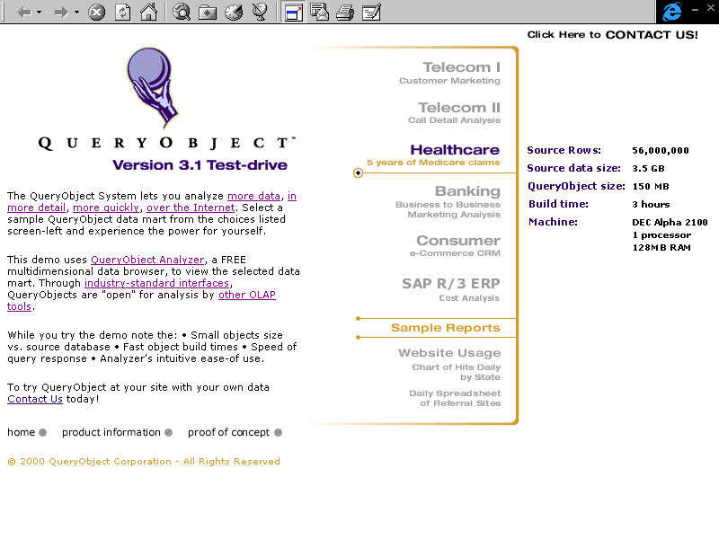

Slide 23
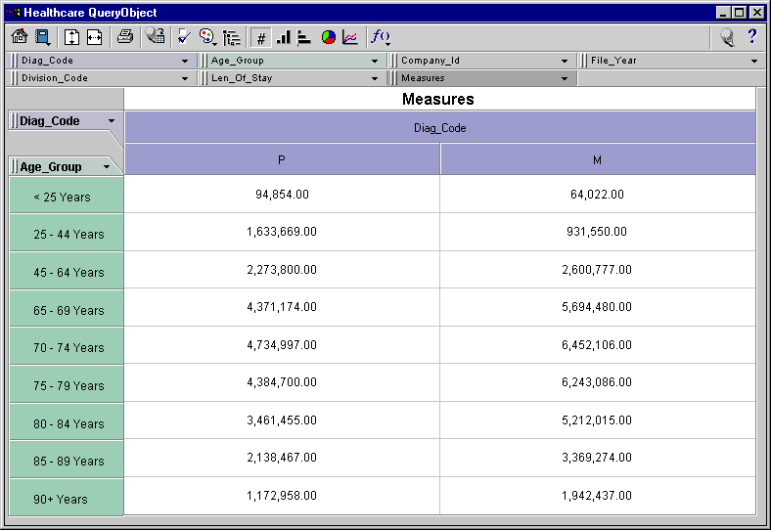

Slide 24
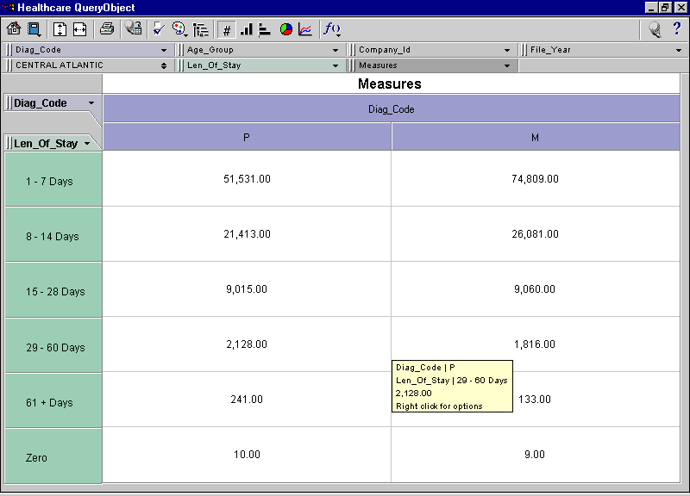

Slide 25
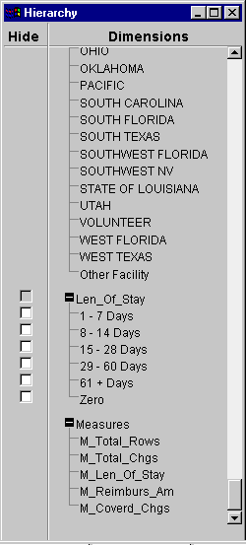

Slide 26
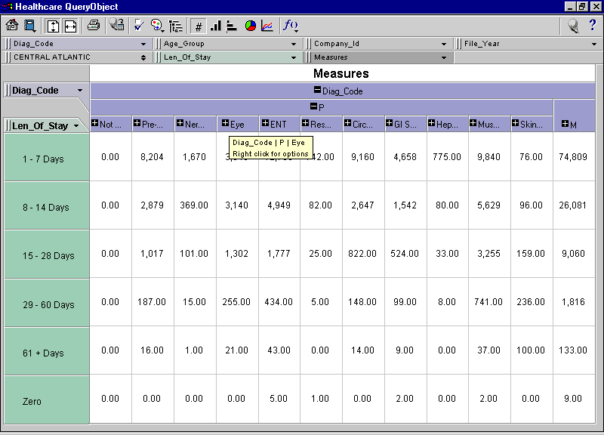

Slide 27
ROLAP

Slide 28
Relational DBMS as Warehouse Server
Schema design
Specialized scan, indexing and join techniques
Handling of aggregate views (querying and materialization)
Supporting query language extensions beyond SQL
Complex query processing and optimization
Data partitioning and parallelism

Slide 29
MOLAP vs. OLAP
Commercial offerings of both types are available
In general, MOLAP is good for smaller warehouses and is optimized for canned queries
In general, ROLAP is more flexible and leverages relational technology on the data server and uses a ROLAP server as intermediary. May pay a performance penalty to realize flexibility

Slide 30
Tools: Warehouse Servers
The RDBMS dominates:
  Oracle 8i/9i
  IBM DB2
  Microsoft SQL Server
  Informix (IBM)
  Red Brick Warehouse (Informix/IBM)
  NCR Teradata
  Sybase…

Slide 31
Tools: OLAP Servers
Support multidimensional OLAP queries
Often characterized by how the underlying data stored
Relational OLAP (ROLAP) Servers
  Data stored in relational tables
  Examples: Microstrategy Intelligence Server, MetaCube (Informix/IBM)
Multidimensional OLAP (MOLAP) Servers
  Data stored in array-based structures
  Examples: Hyperion Essbase, Fusion (Information Builders)
Hybrid OLAP (HOLAP)
  Examples: PowerPlay (Cognos), Brio, Microsoft Analysis Services, Oracle Advanced Analytic Services

Slide 32
Tools: Extraction, Transformation, & Load (ETL)
Cognos Accelerator
Copy Manager, Data Migrator for SAP, PeopleSoft (Information Builders)
DataPropagator (IBM)
ETI Extract (Evolutionary Technologies)
Sagent Solution (Sagent Technology)
PowerMart (Informatica)…

Slide 33
Tools: Report & Query
Actuate e.Reporting Suite (Actuate)
Brio One (Brio Technologies)
Business Objects
Crystal Reports (Crystal Decisions)
Impromptu (Cognos)
Oracle Discoverer, Oracle Reports
QMF (IBM)
SAS Enterprise Reporter…

Slide 34
Tools: Data Mining
BusinessMiner (Business Objects)
Decision Series (Accrue)
Enterprise Miner (SAS)
Intelligent Miner (IBM)
Oracle Data Mining Suite
Scenario (Cognos)…

Slide 35
Data Mining: A brief overview
Discovering patterns in data

Slide 36
Intelligent Problem Solving
Knowledge = Facts + Beliefs + Heuristics
Success = Finding a good-enough answer with the resources available
Search efficiency directly affects success

Slide 37
Focus on Knowledge
Several difficult problems do not have tractable algorithmic solutions
Human experts achieve high level of performance through the application of quality knowledge
Knowledge in itself is a resource. Extracting it from humans and putting it in computable forms reduces the cost of knowledge reproduction and exploitation

Slide 38
Value of Information
Exponential growth in information storage
Tremendous increase in information retrieval
Information is a factor of production
Knowledge is lost due to information overload

Slide 39
KDD vs. DM
Knowledge discovery in databases
  “non-trivial extraction of implicit, previously unknown and potentially useful knowledge from data”
Data mining
  Discovery stage of KDD

Slide 40
Knowledge discovery in databases
Problem definition
Data selection
Cleaning
Enrichment
Coding and organization
DATA MINING
Reporting

Slide 41
Problem Definition
Examples
  What factors affect treatment compliance?
  Are there demographic differences in drug effectiveness?
  Does patient retention differ among doctors and diagnoses?

Slide 42
Data Selection
Which patients?
Which doctors?
Which diagnoses?
Which treatments?
Which visits?
Which outcomes?

Slide 43
Cleaning
Removal of duplicate records
Removal of records with gaps
Enforcement of check constraints
Removal of null values
Removal of implausible frequent values

Slide 44
Enrichment
Supplementing operational data with outside data sources
  Pharmacological research results
  Demographic norms
  Epidemiological findings
  Cost factors
  Medium range predictions

Slide 45
Coding and Organizing
Un-Normalizing
Rescaling
Nonlinear transformations
Categorizing
Recoding, especially of null values

Slide 46
Reporting
Key findings
Precision
Visualization
Sensitivity analysis

Slide 47
Why Data Mining?
Claims analysis - determine which medical procedures are claimed together.
Predict which customers will buy new policies.
Identify behavior patterns of risky customers.
Identify fraudulent behavior.
Characterize patient behavior to predict office visits.
Identify successful medical therapies for different illnesses.

Slide 48
Data Mining Methods
Verification
  OLAP flavors
  Browsing of data or querying of data
  Human assisted exploration of data
Discovery
  Using algorithms to discover rules or patterns

Slide 49
Data Mining Methods
Artificial neural networks: Non-linear predictive models that learn through training and resemble biological neural networks in structure.
Genetic algorithms: Optimization techniques that use processes such as genetic combination, mutation, and natural selection in a design based on the concepts of natural evolution.
Decision trees: Tree-shaped structures that represent sets of decisions. These decisions generate rules for the classification of a dataset.
Nearest neighbor method: A technique that classifies each record in a dataset based on a combination of the classes of the k record(s) most similar to it in a historical dataset (where k 1). Sometimes called the k-nearest neighbor technique.
Rule induction: The extraction of useful if-then rules from data based on statistical significance.
Data visualization: The visual interpretation of complex relationships in multidimensional data. Graphics tools are used to illustrate data relationships.

Slide 50
Types of discovery
Association
  identifying items in a collection that occur together
    popular in marketing
Sequential patterns
  associations over time
Classification
  predictive modeling to determine if an item belongs to a known group
    treatment at home vs. at the hospital
Clustering
  discovering groups or categories

Slide 51
Association: A simple example
Total transactions in a hardware store = 1000
number which include hammer = 50
number which include nails = 80
number which include lumber = 20
number which include hammer and nails = 15
number which include nails and lumber = 10
number which include hammer, nails and lumber = 5

Slide 52
Association Example
Support for hammer and nails = .015 (15/1000)
Support for hammer, nails and lumber = .005 (5/1000)
Confidence of “hammer ==>nails” =.3 (15/50)
Confidence of “nails ==> hammer”=15/80
Confidence of “hammer and nails ===> lumber” = 5/15
Confidence of “lumber ==> hammer and nails” = 5/20

Slide 53
Association: Summary
Description of relationships observed in data
Simple use of bayes theorem to identify conditional probabilities
Useful if data is representative to take action
  market basket analysis

Slide 54
Bayesian Analysis
New Information
Prior Probabilities
Bayesian
Analysis
Posterior
Probabilities

Slide 55
A Medical Test
A doctor must treat a patient who has a tumor. He knows that 70 percent of similar tumors are benign. He can perform a test, but the test is not perfectly accurate. If the tumor is malignant, long experience with the test indicates that the probability is 80 percent that the test will be positive, and 10 percent that it will be negative; 10 percent of the tests are inconclusive. If the tumor is benign, the probability is 70 percent that the test will be negative, 20 percent that it will be positive; again, 10 percent of the tests are inconclusive. What is the significance of a positive or negative test?

Slide 56
.2 Test positive
.7 Benign
.1 Inconclusive
.7 Test negative
.8 Test positive
.3 Malignant
.1 Inconclusive
.1 Test negative

Slide 57
Benign
Test Positive
Malignant
Benign
Test inconclusive
Malignant
Benign
Test negative
Malignant

Slide 58
Path probability
.2 Test Positive
.14
.7 Benign
.1 Test inconclusive
.07
.7 Test negative
.49
.8 Test positive
.24
.3 Malignant
.1 Test inconclusive
.03
.1 Test negative
.03
Path probability
Benign
.14
Test positive
.14/.38 = .368
.14 + .24 = .38
Malignant
.24
.27/.38 = .632
Benign
.07
Test inconclusive
.07/.10 = .7
.07 + .03 = .10
Malignant
.03
.03/.10 = .3
Benign
.49
Test negative
.49/.52 = .942
.49 + .03 = .52
Malignant
.03
.03/.52 = .058

Slide 59
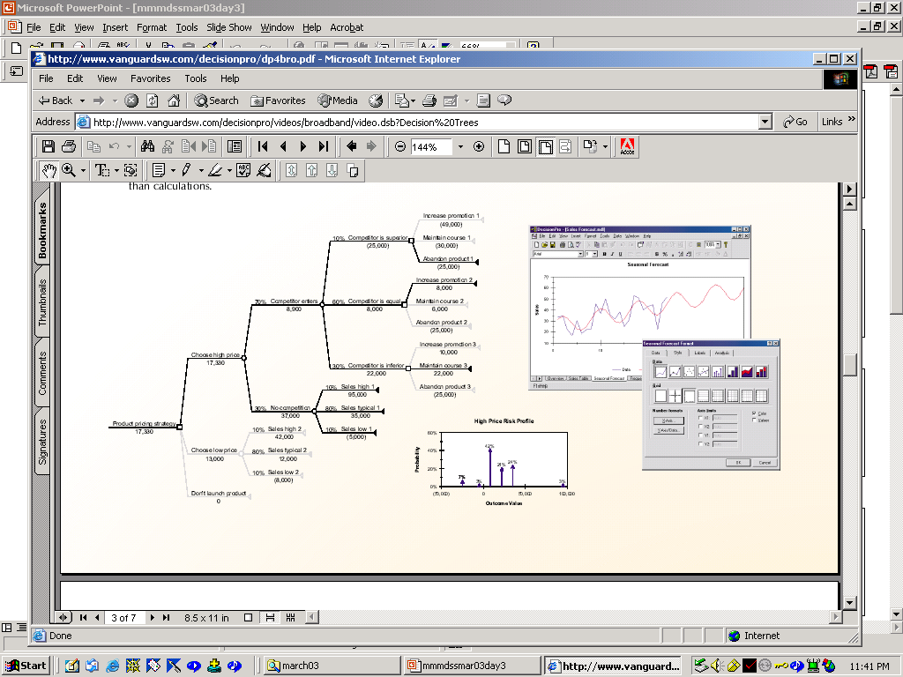
Decision pro

Slide 60
Rule-based Systems
A rule-based system consists of a data base containing the valid facts, the rules for inferring new facts and the rule interpreter for controlling the inference process
Goal-directed
Data-directed
Hypothesis-directed

Slide 61
Classification
Identify the characteristics that indicate the group to which each case belongs
  pneumonia patients: treat at home vs. treat in the hospital
  several methods available for classification
    regression
    neural networks
    decision trees

Slide 62
Generic Approach
Given data set with a set of independent variables (key clinical findings, demographics, lab and radiology reports) and dependent variables (outcome)
Partition into training and evaluation data set
Choose classification technique to build a model
Test model on evaluation data set to test predictive accuracy

Slide 63
Multiple Regression
Statistical Approach
  independent variables: problem characteristics
  dependent variables: decision
    the general form of the relationship has to be known in advance (e.g., linear, quadratic, etc.)

Slide 64
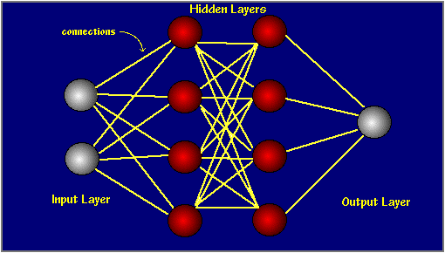
Neural Nets
Source: GMS Lab,UIUC

Slide 65
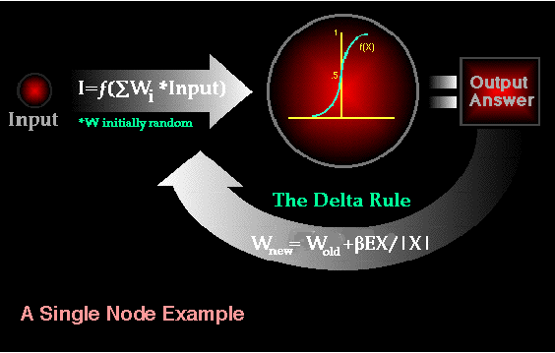
Neural Nets
Source: GMS Lab,UIUC

Slide 66
Neural networks
Nodes are variables
Weights on links by training the network on the data
Model designer has to make choices about the structure of the network and the technique used to determine the weights
Once trained on the data, the neural network can be used for prediction

Slide 67
Neural Networks: Summary
widely used classification technique
mostly used as a black box for predictions after training
difficult to interpret the weights on the links in the network
can be used with both numeric and categorical data

Slide 68
Myocardial Infarction Network
(Ohno-Machado et al.)
Duration
Intensity
Elevation
Pain
Pain
ECG: ST
Smoker
Age
Male
2
4
1
1
50
1
Myocardial Infarction
“Probability” of MI
0.8

Slide 69
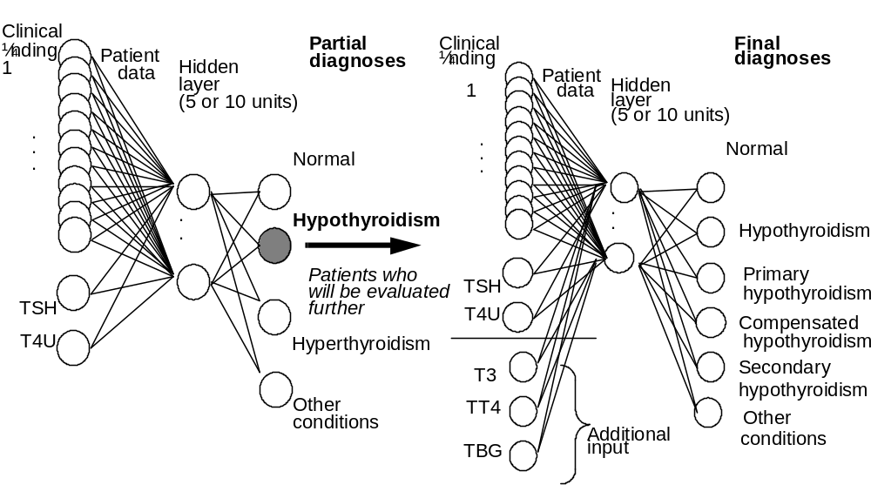
Thyroid Diseases
(Ohno-Machado et al.)

Slide 70
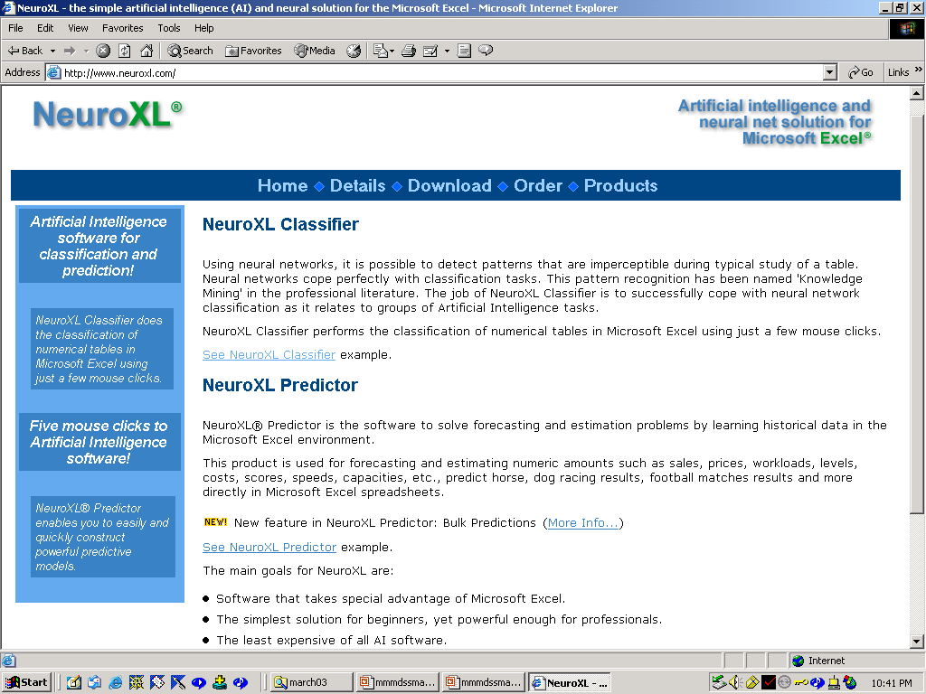

Slide 71
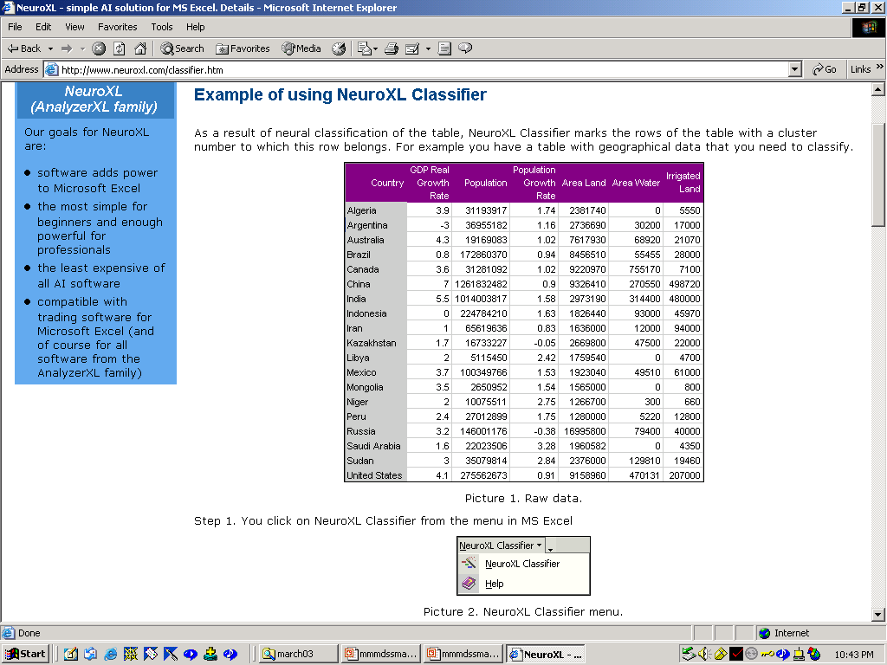

Slide 72
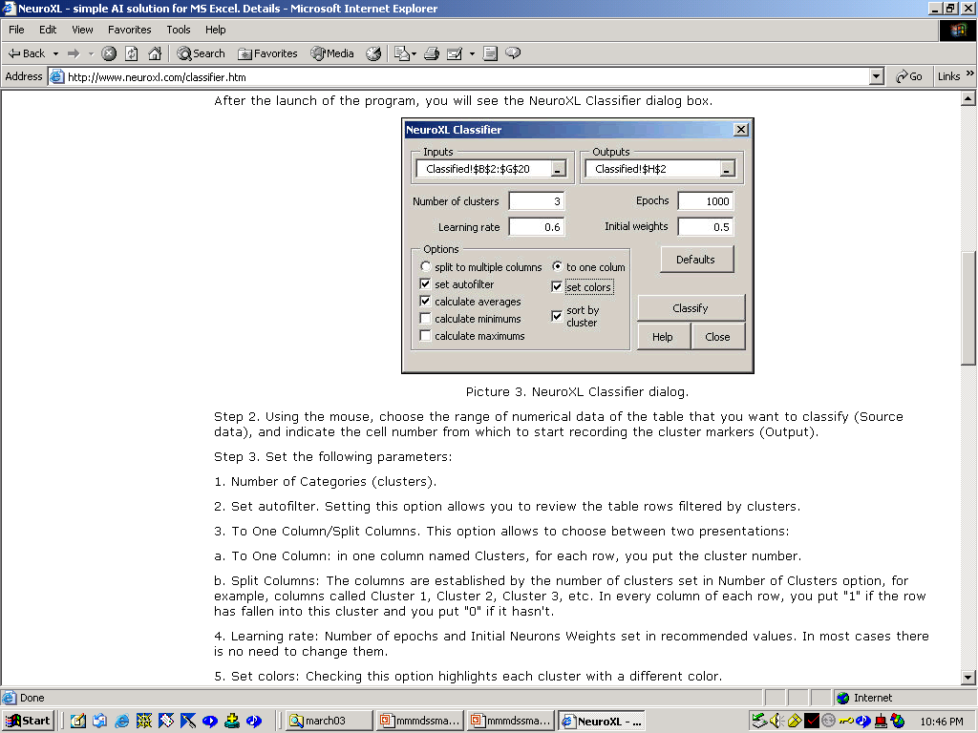

Slide 73
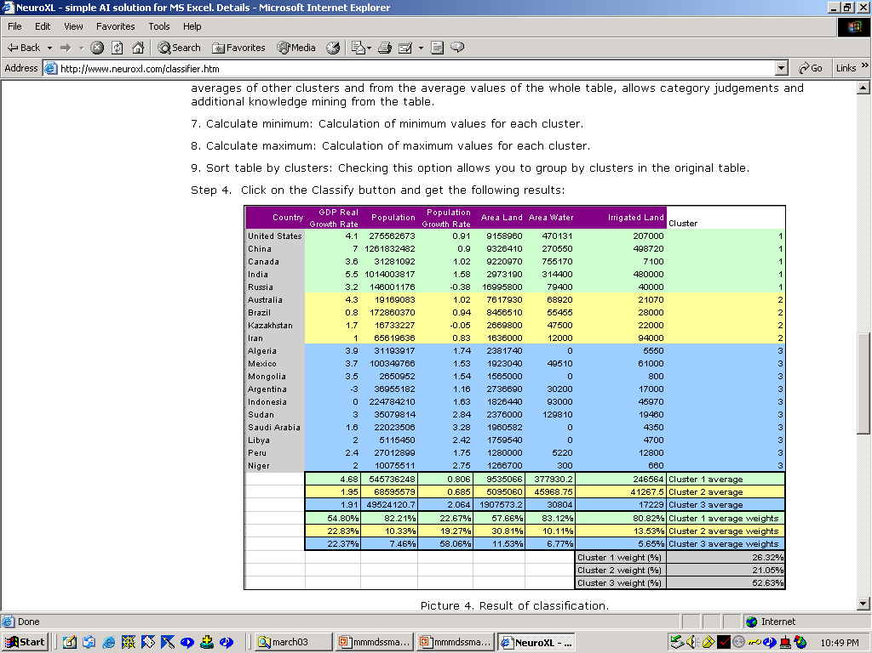

Slide 74
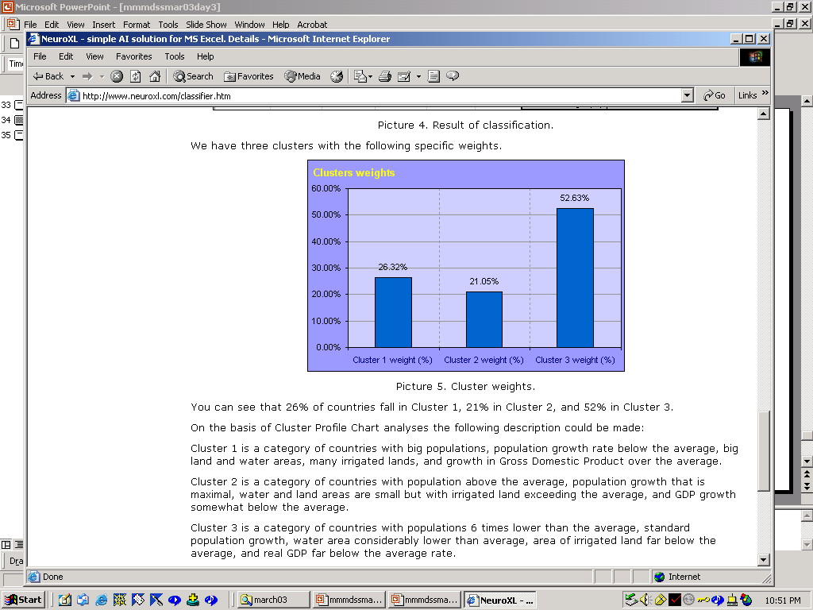

Slide 75
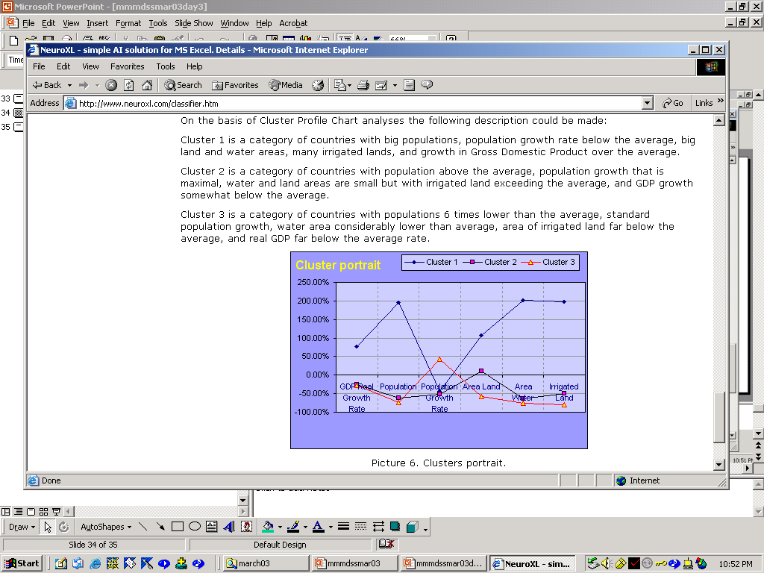

Slide 76
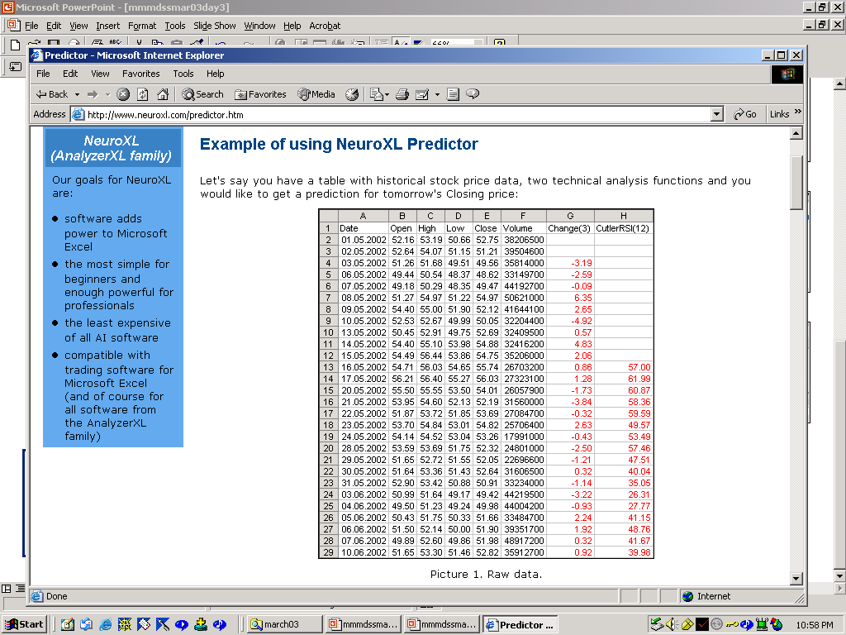

Slide 77
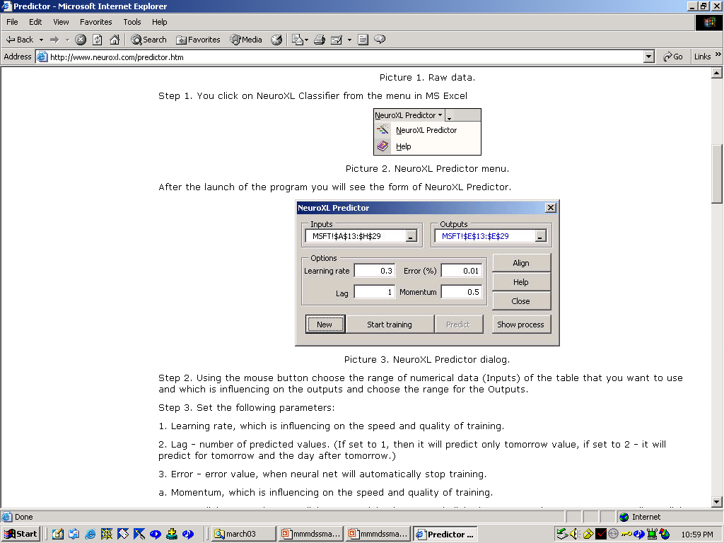

Slide 78
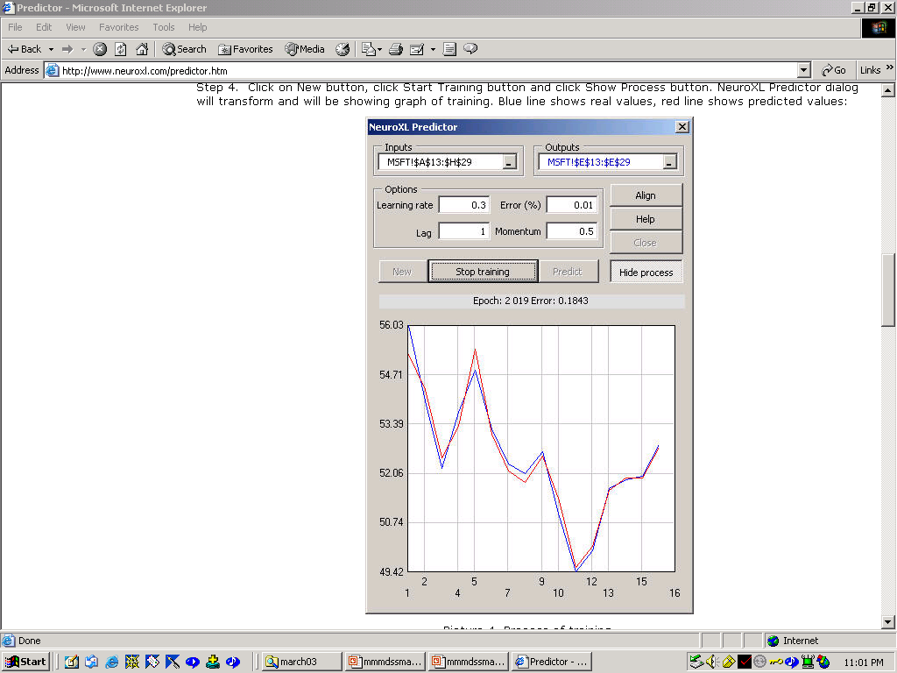

Slide 79
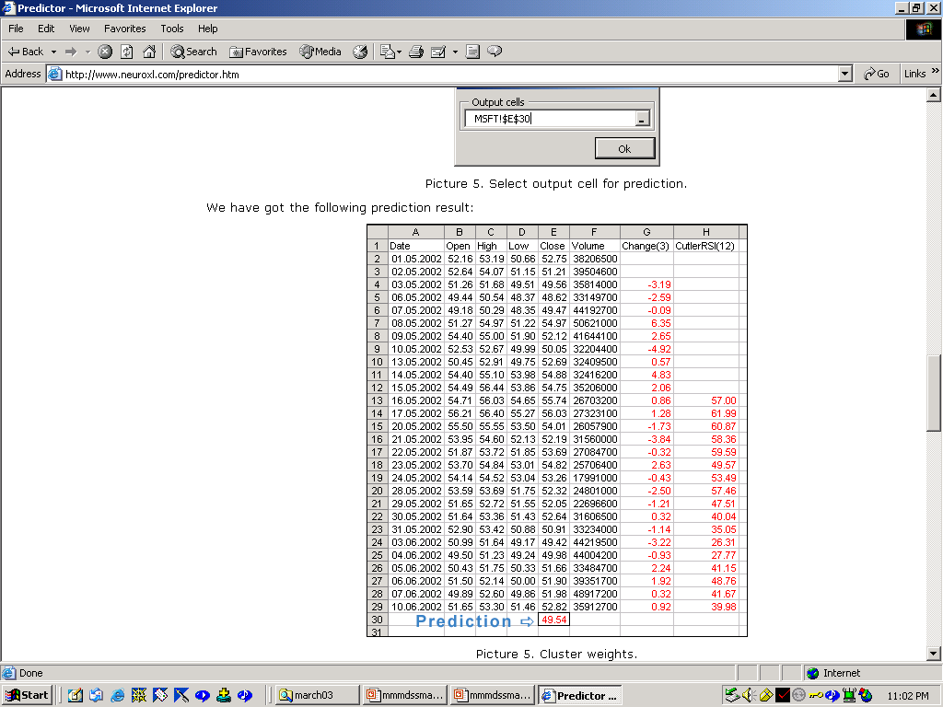

Slide 80
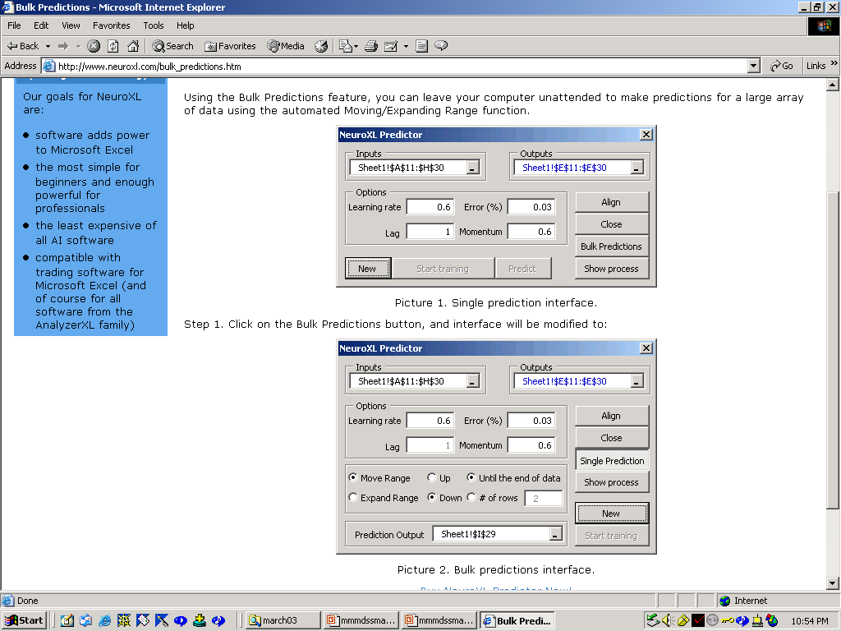

Slide 81
Model Comparison
(Ohno-Machado et al.)
Modeling Examples Explanation
Effort Needed Provided
Rule-based Exp. Syst. high low high
Bayesian Nets high low moderate
Classification Trees low high “high”
Neural Nets low high low
Regression Models high moderate moderate

Slide 82
Summary
Neural Networks are
mathematical models that resemble nonlinear regression models, but are also useful to model nonlinearly separable spaces
“knowledge acquisition tools” that learn from examples
Neural Networks in Medicine are used for:
  pattern recognition (images, diseases, etc.)
  exploratory analysis, control
  predictive models

Slide 83
Case for Change (PriceWaterhouseCoopers 2003)
Creating the future hospital system
  Focus on high-margin, high-volume, high-quality services
  Strategically price services
  Understand demands on workers
  Renew and replace aging physical structures
  Provide information at the fingertips
  Support physicians through new technologies

Slide 84
Case for Change (PriceWaterhouseCoopers 2003)
Creating the future payor system
  Pay for performance
  Implement self-service tools to lower costs and shift responsibility
  Target high-volume users through predictive modeling
  Move to single-platform IT and data warehousing systems
  Weigh opportunities, dilemmas amid public and private gaps

